Slide 1

Capstone Project
A food image classifier using convolutional neural networks.
A Deep Learning application.

Slide 2

Wellio’s challenge: empower every person to achieve a healthier diet.
Learn Language, Image, Videos
Learn human behavior and outcomes
Recipe
Cuisine type
Plan
Execute
Measure
Nutrition
Ingredient term
AI
4
Eating
Substitute
ingredients
Preparation
Instructions

Slide 3
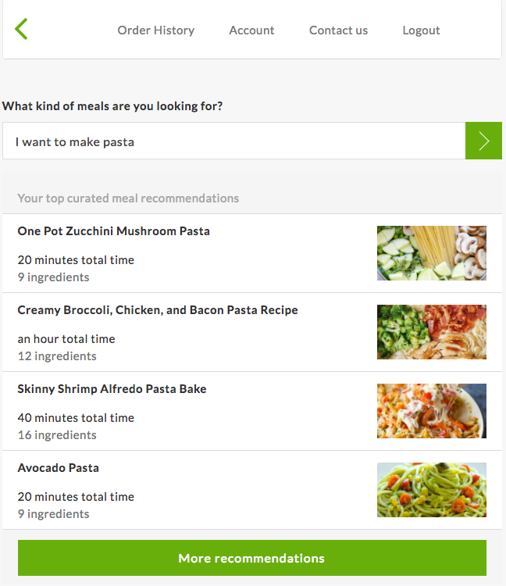
Wellio’s recommendation system allows a user to ask for recipe through a conversational interface.

Slide 4
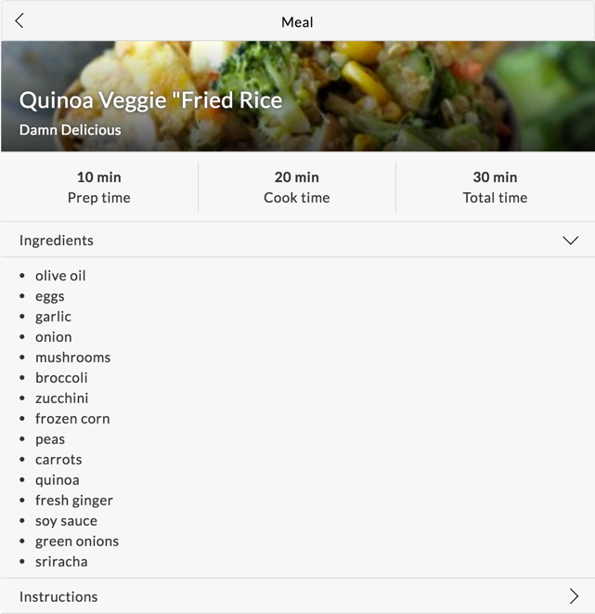
Wellio has noticed that customers tend to choose recipes that are more visually appealing when we displaying results.

Slide 5
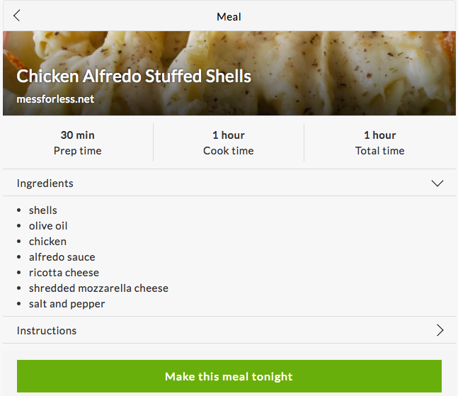
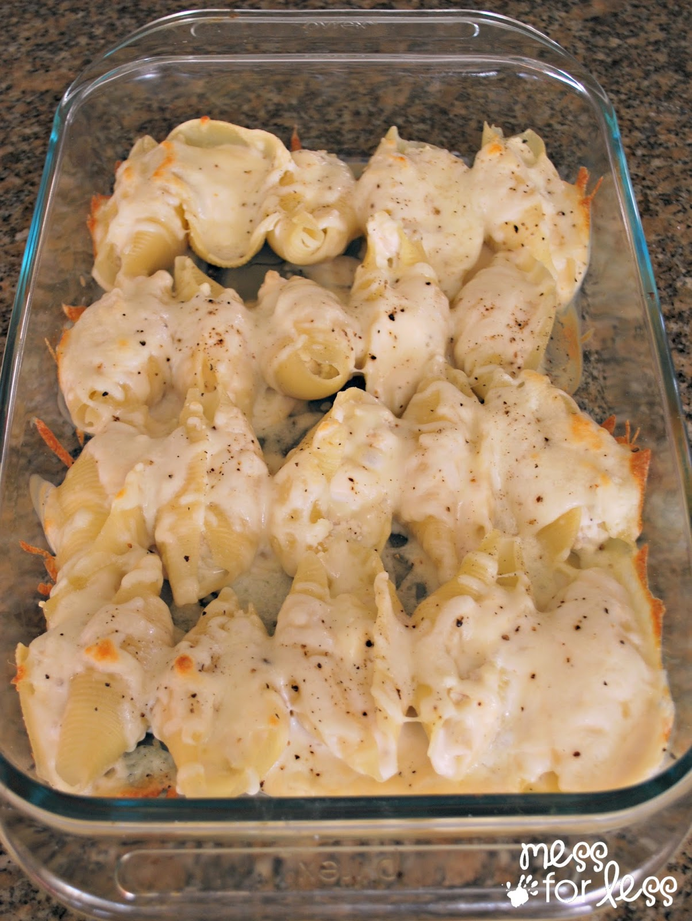
Wellio has noticed that customers tend to choose recipes that are more visually appealing when we displaying results.

Slide 6
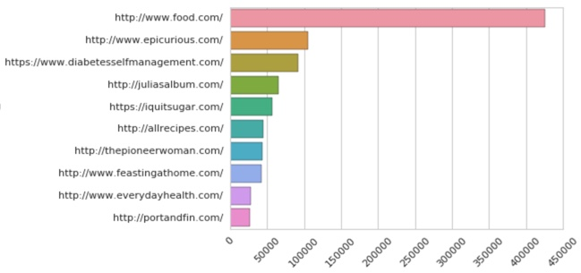
Sources of data*.
*close to 2M recipes

Slide 7
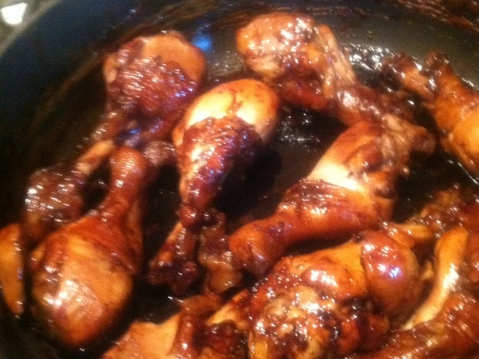
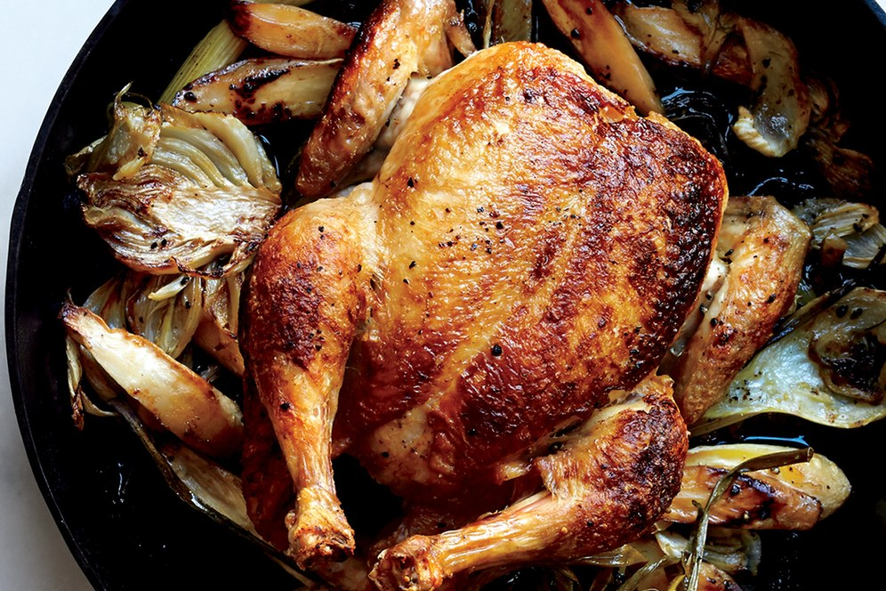
Wellio needs to classify images of recipes to appealing/not appealing using CNN. Left: user generated photo (food.com) Right: professional photo (epicurious.com)

Slide 8
Transfer Learning Using InceptionV3.
Notes:
Why? Very deep architecture and trained on millions of images.

Slide 9
Transfer Learning Using InceptionV3.

Slide 10
Transfer Learning Using InceptionV3.
The 'Inception v3' architecture model trained to classify images against 1,000 different 'ImageNet' categories, and using its penultimate "bottleneck" layer, is used to train a new top layer that can recognize other classes of images, like "tasty" or "not-tasty" in this project.
Notes:
The new top layer does not need to be very complex, and that we typically don't need much data or much training of this new model, to get good results for our new image classifications.

Slide 11
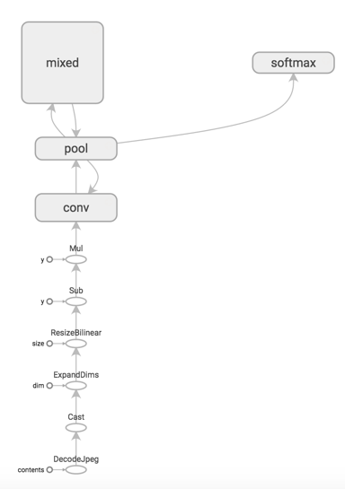
Transfer Learning Using InceptionV3.
InceptionV3 graph.

Slide 12
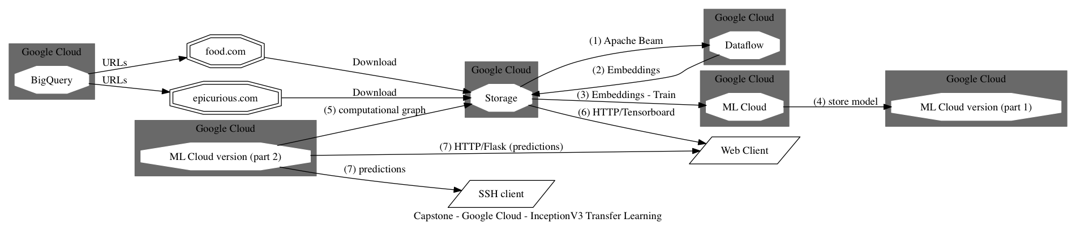
Transfer Learning Using InceptionV3.
Notes:
Apache Beam for image pre-processing using Google Dataflow:
The pipeline uses Inception v3 to generate the inputs to the new 'top layer' that we will train and will use the preprocessing results (TFRecords) to be consumed during training.
Each image is processed to produce its feature representation (an
embedding) which is a k-dimensional vector of floats (in our case, 2,048 dimensions). The preprocessing includes converting the image format, resizing images, and running the converted image through a pre-trained model to get the embeddings).
Google ML Cloud to train the model. The neural network will comprise a single fully- connected layer with RELU activations and with one output for each label to replace the original output layer. The final output is computed using the softmax function. In the training stages, we use dropout to randomly ignore a subset of input weights to prevent over-fitting to the training dataset.
Tensorboard to visualize embeddings, graphs, etc.
Flask web application to make prediction using the model stored in Google ML Cloud.

Slide 13
Transfer Learning Using InceptionV3.
Model going to production in 2 weeks.
Also used features to train Logistic Regression, Naïve-Bayes, Random Forest: only 50% accuracy (these models are shallow).
Notes:
Apache Beam for image pre-processing using Google Dataflow:
The pipeline uses Inception v3 to generate the inputs to the new 'top layer' that we will train and will use the preprocessing results (TFRecords) to be consumed during training.
Each image is processed to produce its feature representation (an
embedding) which is a k-dimensional vector of floats (in our case, 2,048 dimensions). The preprocessing includes converting the image format, resizing images, and running the converted image through a pre-trained model to get the embeddings).
Google ML Cloud to train the model. The neural network will comprise a single fully- connected layer with RELU activations and with one output for each label to replace the original output layer. The final output is computed using the softmax function. In the training stages, we use dropout to randomly ignore a subset of input weights to prevent over-fitting to the training dataset.
Tensorboard to visualize embeddings, graphs, etc.
Flask web application to make prediction using the model stored in Google ML Cloud.

Slide 14
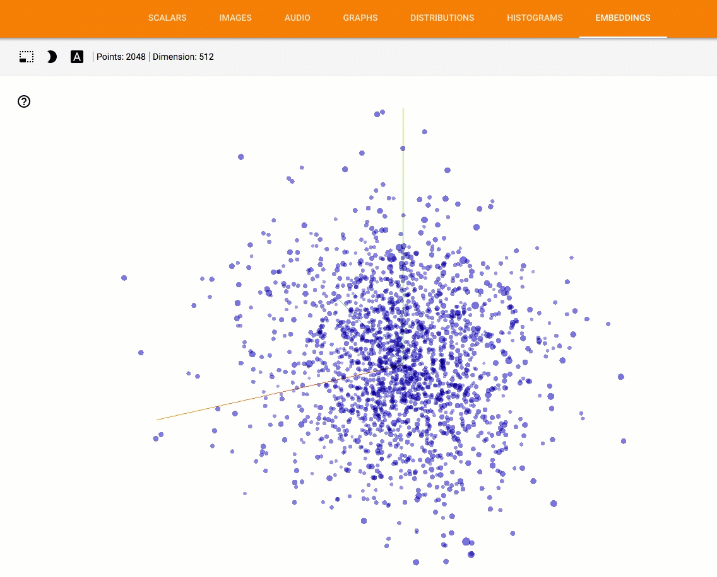
Transfer Learning Using InceptionV3.

Slide 15
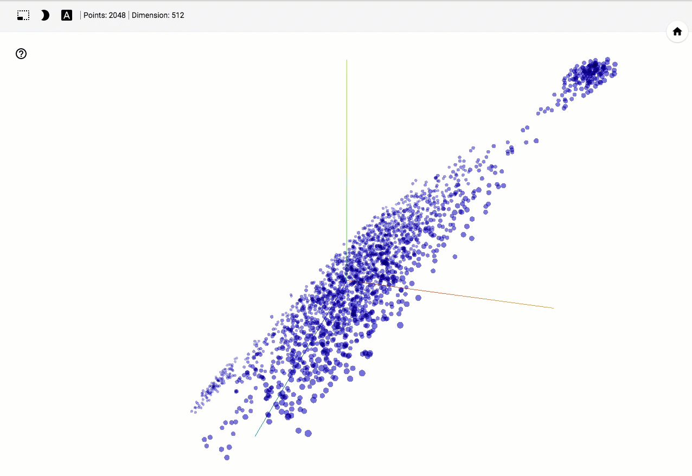
Transfer Learning Using InceptionV3.

Slide 16
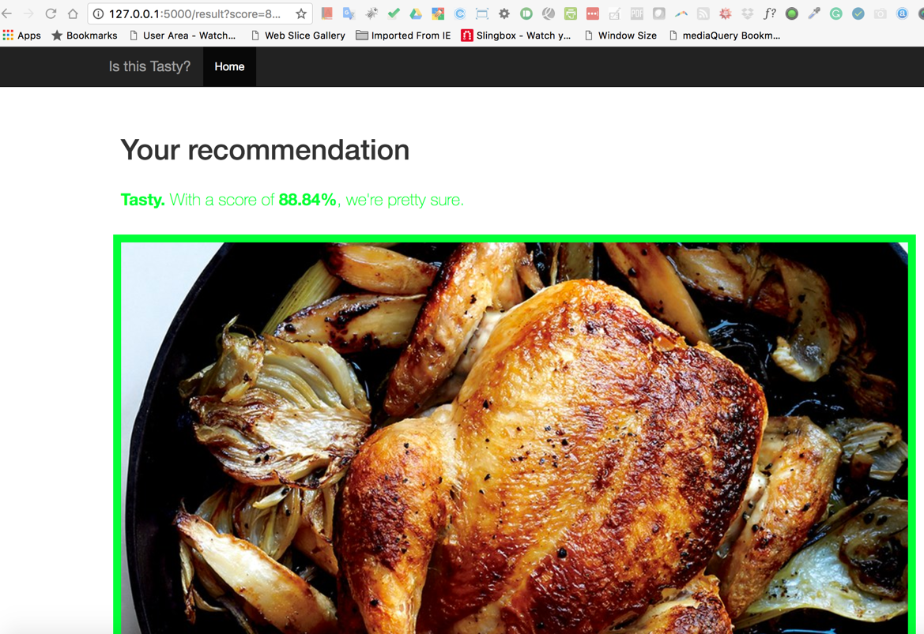
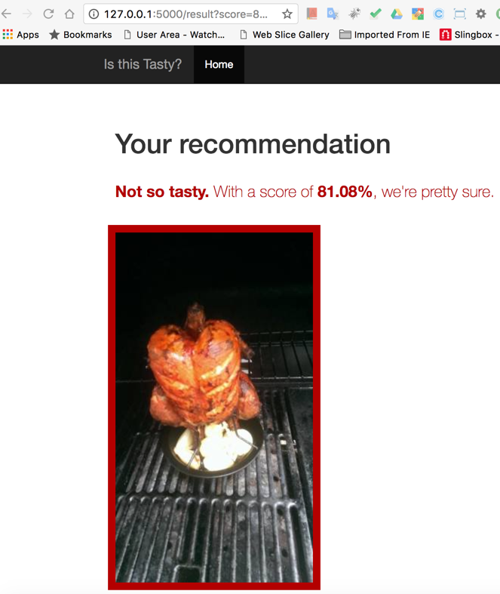
Transfer Learning Using InceptionV3.

Slide 17
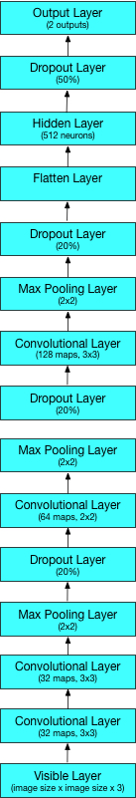
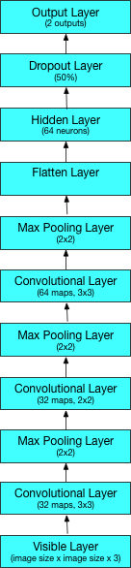
Evaluating Deep Learning Architectures.
Images pre-processed to 25, 50 and 100.
Also used data augmentation.

Slide 18
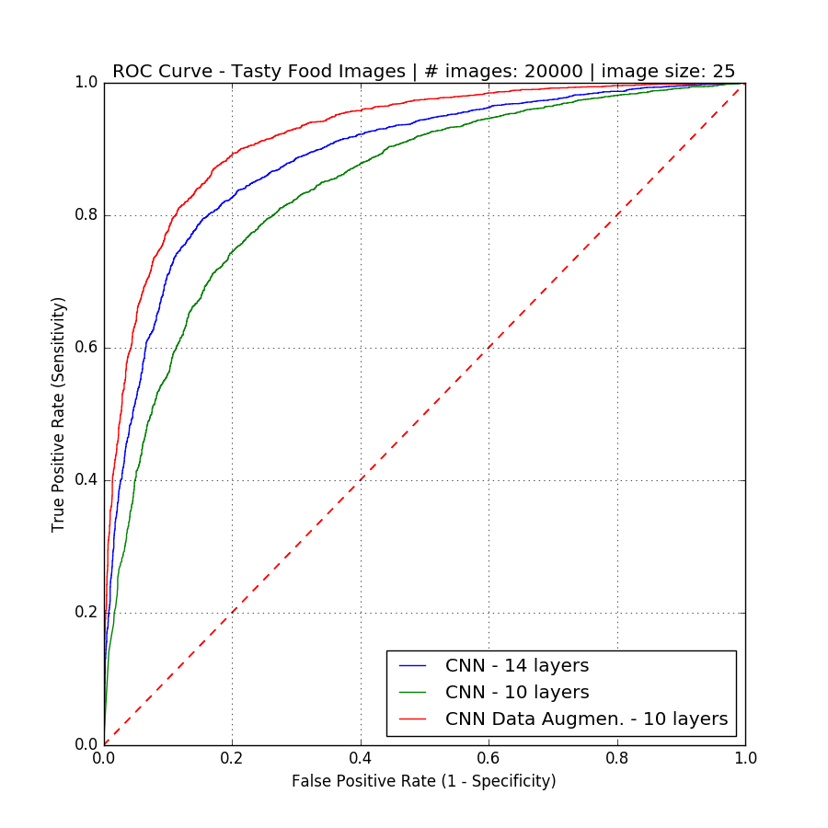
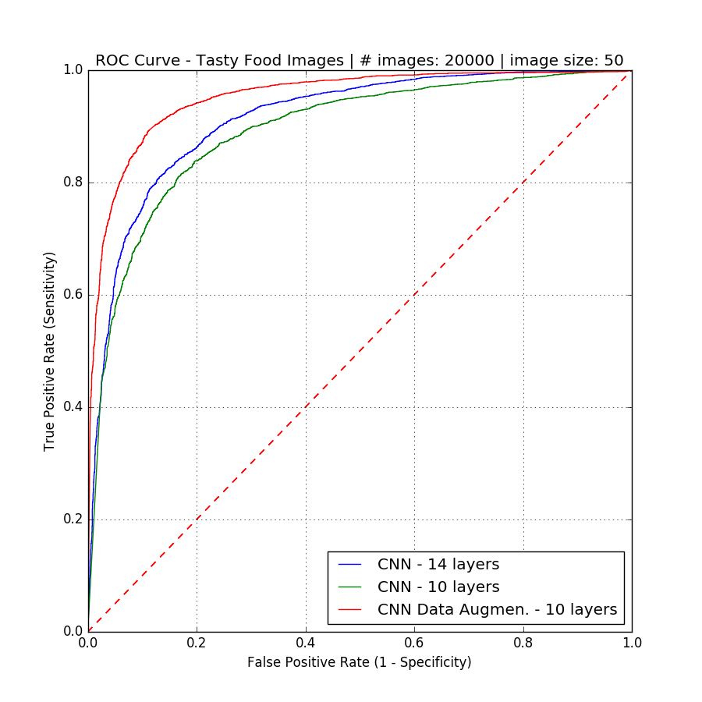
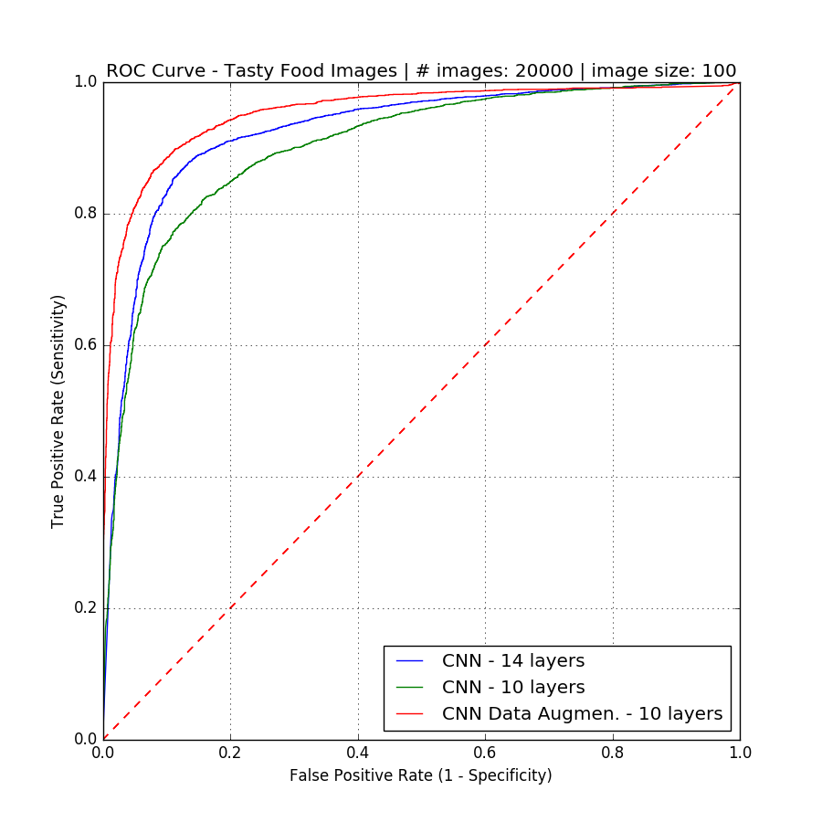
Model Performances vs Image Sizes.
image size

Slide 19
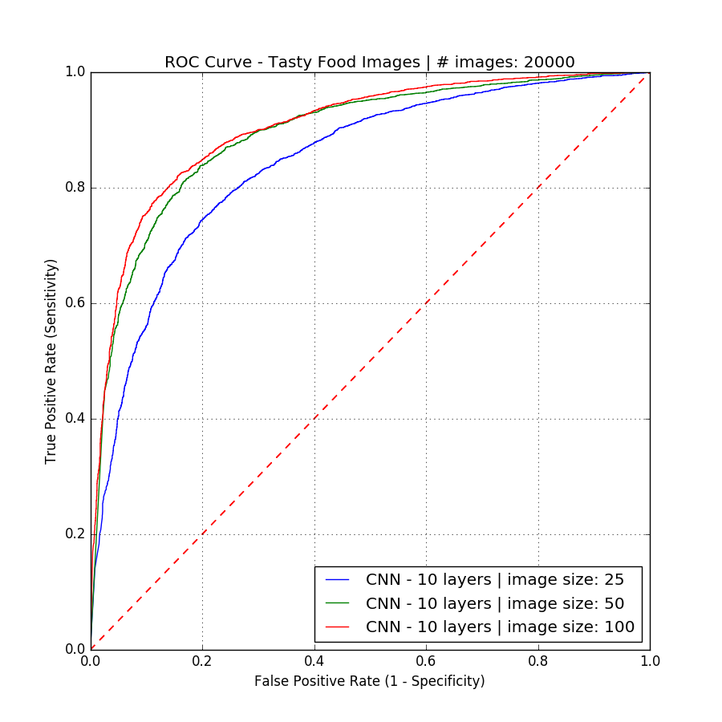
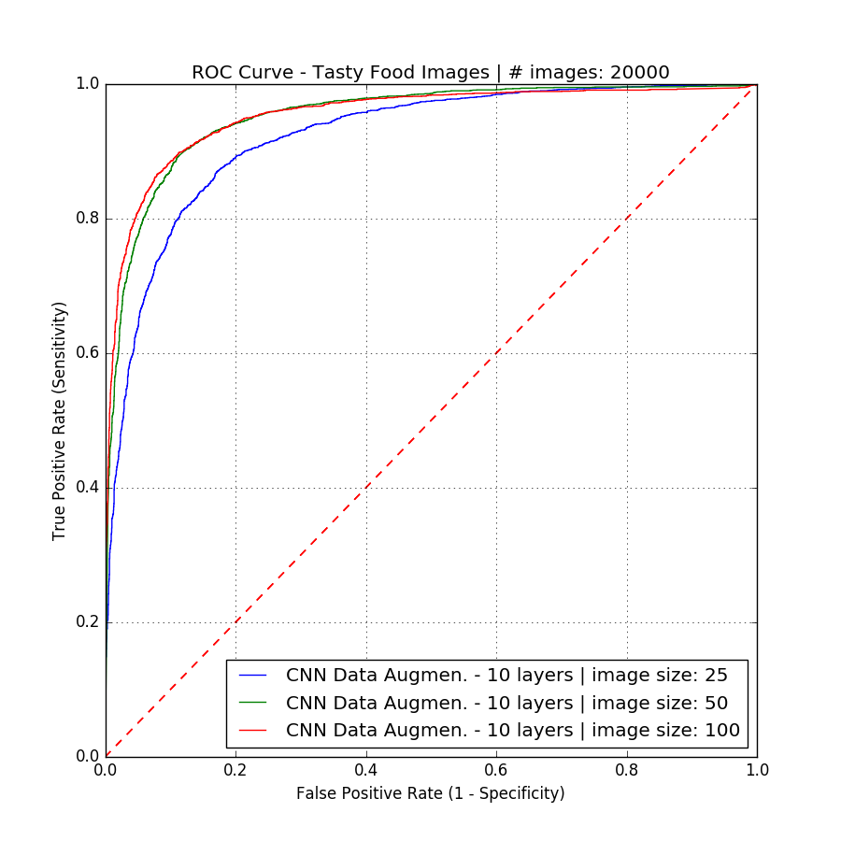
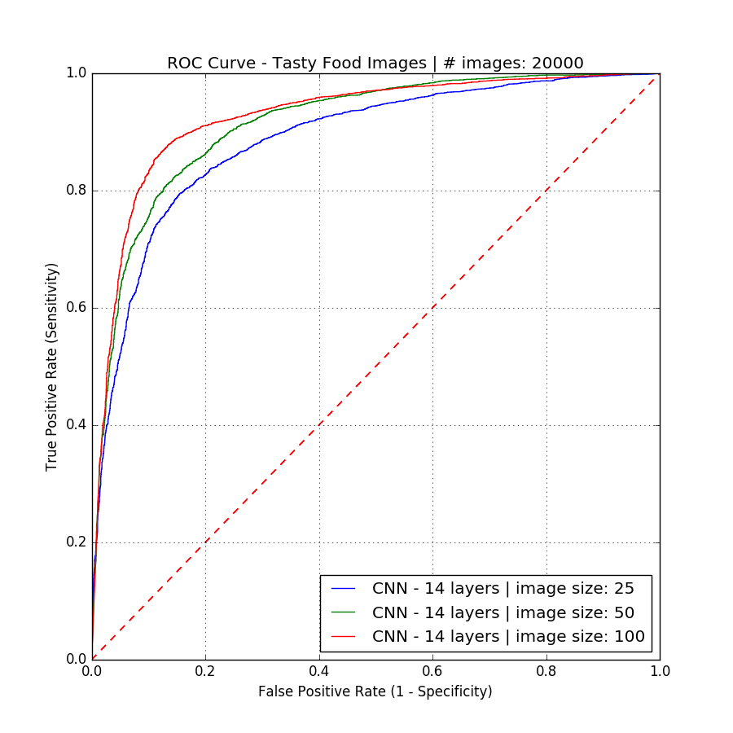
Model Performances vs Model Complexity.
complexity

Slide 20
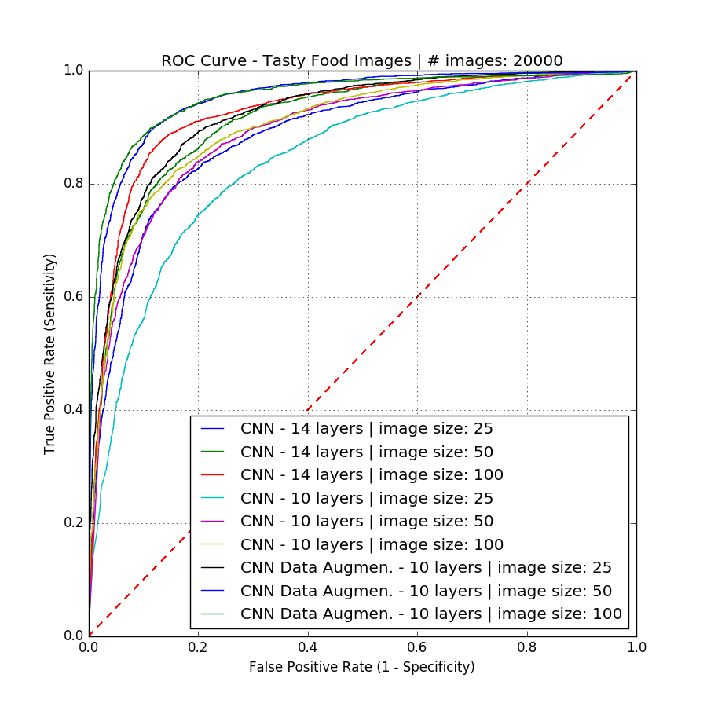
Best Models: with Data Augmentation and Bigger Image Size.

Slide 21
Acknowledgments.
Wellio
Sivan Aldor-Noiman (VP Data Science)
Erik Andrejko (CTO)
Data Science Intern
Pranav Prabhakaran
University of New Haven
Alessandro Gagliardi
Conor Murphy

